Slide 1
Operating Systems
Week#1 – introduction, Goals of os,Functions and services of os

Slide 2
Definitions
A program that acts as an intermediary between a user of a computer and the computer hardware.
An operating system (OS) is the program that, after being initially loaded into the computer by a boot program, manages all the other programs in a computer.
The application programs must be written to run on top of a particular operating system.

Slide 3
Objectives
Convenience
Make the computer convenient to use
Efficiency
Allows computer resources to be used in an efficient manner
Ability to evolve
Due to Hardware Upgrades
For incorporating new features/enhancements
Fixes for bugs and errors

Slide 4
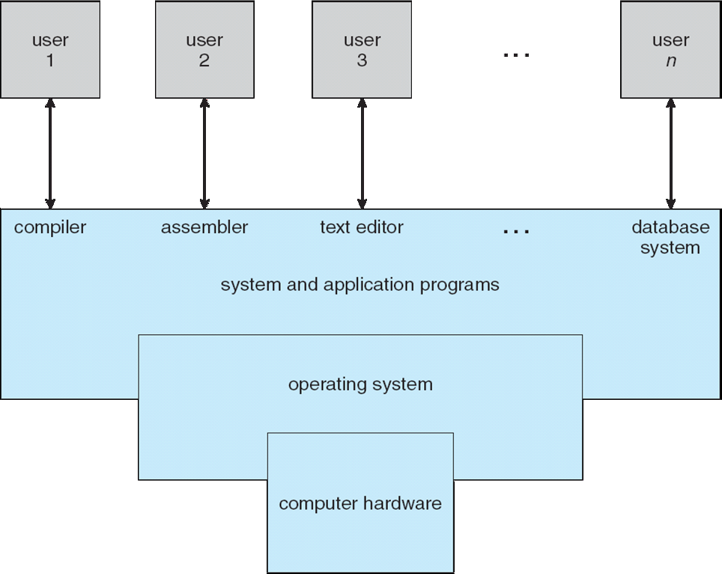
Computer System Architecture

Slide 5
Contd.
Computer system can be divided into four components:
Hardware – provides basic computing resources
CPU, memory, I/O devices
Operating system
Controls and coordinates use of hardware among various applications and users
Application programs – define the ways in which the system resources are used to solve the computing problems of the users
Word processors, compilers, web browsers, database systems, video games
Users
People, machines, other computers

Slide 6
What does it do?
Computer operating systems perform basic tasks, such as:
Recognizing input from the keyboard
Sending output to the display screen
Keeping track of files and directories on the storage drives
Controlling peripheral devices, such as printers.
For large systems, the operating system has even greater responsibilities and powers.
It is like a traffic cop — it makes sure that different programs and users running at the same time do not interfere with each other.
It is also responsible for security

Slide 7
Important Functions/Services Elaborated
Memory Management
Processor Management
Device Management
File Management
Security
Control over system performance
Job accounting
Error detecting aids
Coordination between other software and users

Slide 8
Memory Management
Memory management refers to management of Primary Memory or Main Memory. Main memory is a large array of words or bytes where each word or byte has its own address.
Main memory provides a fast storage that can be accessed directly by the CPU. For a program to be executed, it must in the main memory. An Operating System does the following activities for memory management
Keeps tracks of primary memory, i.e., what part of it are in use by whom, what part are not in use.
In multiprogramming, the OS decides which process will get memory when and how much.
Allocates the memory when a process requests it to do so.
De-allocates the memory when a process no longer needs it or has been terminated.

Slide 9
Processor Management
In multiprogramming environment, the OS decides which process gets the processor when and for how much time. This function is called process scheduling. An Operating System does the following activities for processor management
Keeps tracks of processor and status of process. The program responsible for this task is known as traffic controller.
Allocates the processor (CPU) to a process.
De-allocates processor when a process is no longer required.

Slide 10
Device Management
An Operating System manages device communication via their respective drivers. It does the following activities for device management −
Keeps tracks of all devices. Program responsible for this task is known as the I/O controller.
Decides which process gets the device when and for how much time.
Allocates the device in the efficient way.
De-allocates devices.

Slide 11
File Management
A file system is normally organized into directories for easy navigation and usage. These directories may contain files and other directions. An Operating System does the following activities for file management:
Keeps track of information, location, uses, status etc. The collective facilities are often known as file system.
Decides who gets the resources.
Allocates the resources.
De-allocates the resources.

Slide 12
Other important services
Following are some of the other important activities that an Operating System performs:
Security − By means of password and similar other techniques, it prevents unauthorized access to programs and data.
Control over system performance − Recording delays between request for a service and response from the system.
Job accounting − Keeping track of time and resources used by various jobs and users.
Error detecting aids − Production of dumps, traces, error messages, and other debugging and error detecting aids.
Coordination between other softwares and users − Coordination and assignment of compilers, interpreters, assemblers and other software to the various users of the computer systems.

Slide 13
THANK YOU!

